Slide 1

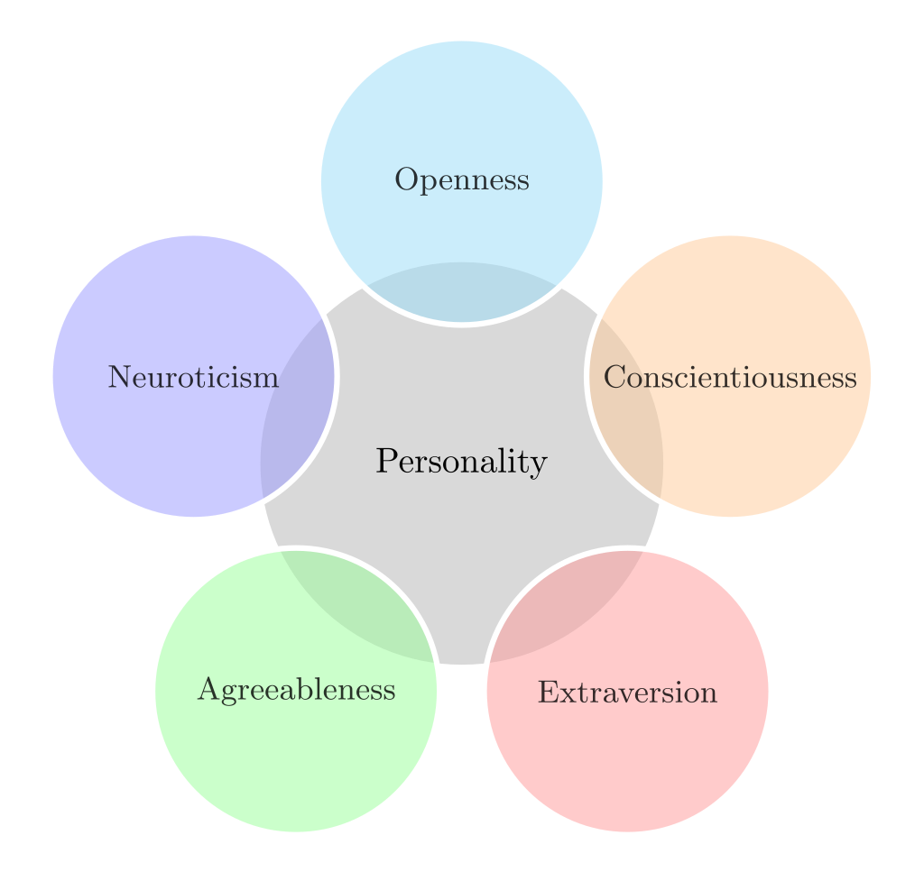

Multi-Cultural Personality Profiling &
Classifying The Israeli Profile
Cover
Guy Hen
Advisor: Dror Jacoby

Slide 2
Introduction/Motivation
Introduction
Israel is a unique entity in the middle-eastern landscape. While other countries in the area are ruled by Islam, Israel is mainly Jewish. While the rest of the middle east rejects democracy, Israel is a democracy. A significant point of differentiation between Israel and other countries in the area is the integration of western characteristics into Israel – Israel considers itself a country that chose to adopt western culture and values in an environment which is mostly hostile towards those values.
This project wished to better understand the nature of Israel, by researching its population. Specifically, we were interested in learning about the Israeli personality profile - could you really call it western? What is the right classification for it?
We pursued those questions by creating personality profiles for diverse countries representing different cultures and tested their personality traits against the Israeli traits. The project focused on three prominent cultures: The West, The Arab World and The Far East.
We hypothesized that the Israeli profile could be classified as a western profile but were also open to other possibilities - the most interesting one would be showing distinct differentiations from all three cultures.
Another sub-goal was to detect general intriguing differences between the various cultures and countries in the study.

Slide 3
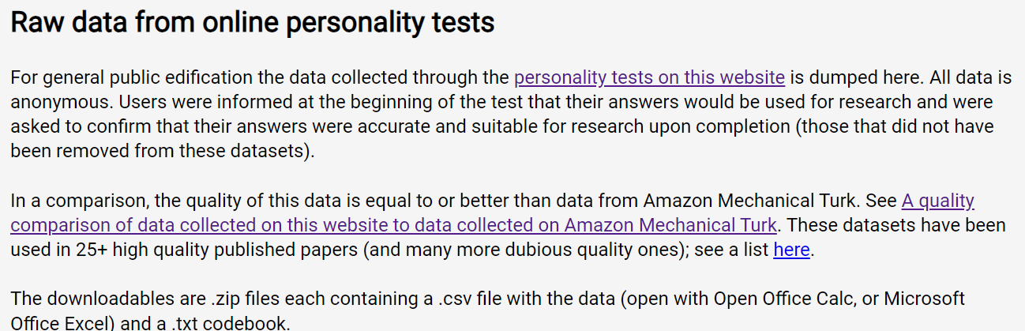
Methodology
Methodology
Utilized an Open-Source international website that gathered 46 datasets of personality tests, including large samples and demographic variables. The data went through quality checks and was used in high quality published papers.
https://openpsychometrics.org/_rawdata/

Slide 4
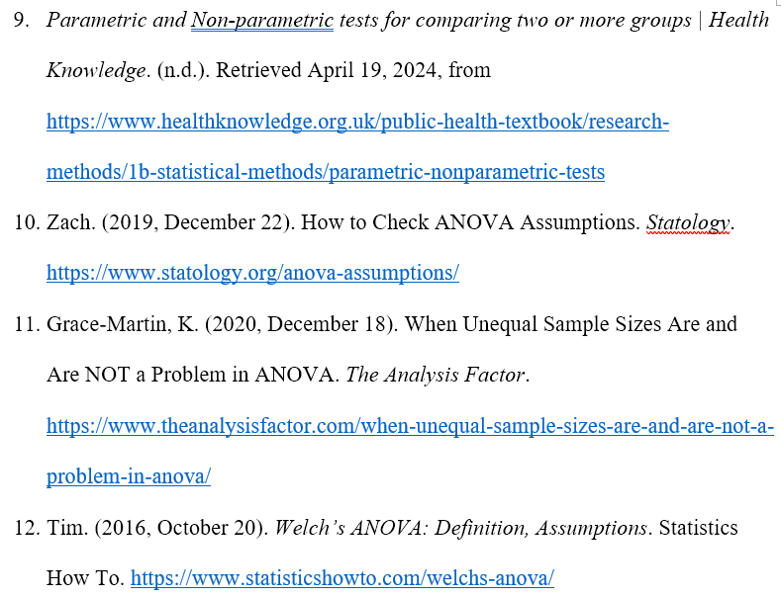
Methodology
Methodology
Full documentation of the project workflow is provided via Word files.
Thorough research (over 75 citations) of relevant literature was conducted to establish justifications for various choices made in the project.

Slide 5
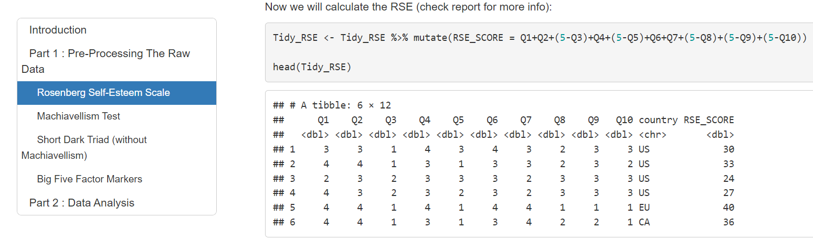
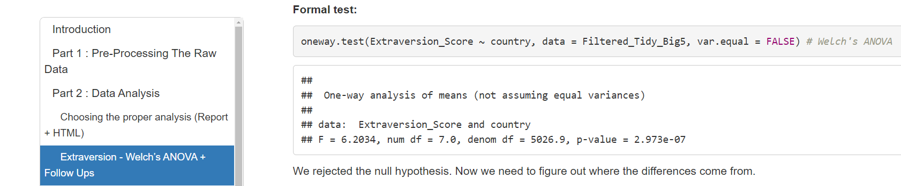
Methodology
Methodology
Utilized HTML for comfortable presentation of data preprocessing and analysis.

Slide 6
Methodology
Methodology
Main tools:
R for data importing, cleaning, transformations, handling missing values, outlier detection and treatment, visualizations, and analysis.
Rstudio was used as the working environment.

Slide 7
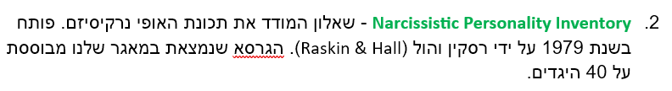
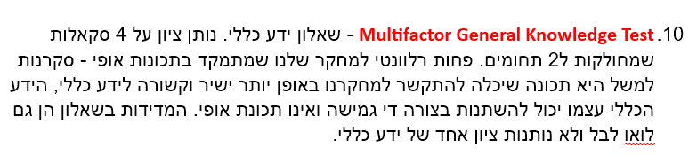
Workflow
Workflow
Defined the criteria for the dependent variables we wanted to gather to create a personality profile – distinct, specific, personality traits.
Conducted a conceptual review of all the personality tests in our source and filtered the tests which fit our criteria.
Research Stage
Pre-Processing Stage
Data Analysis Stage

Slide 8
Workflow
Workflow
Conducted a technical review of the tests which passed the conceptual review to verify the data was usable for our purposes (has country data, has at least 25 Israeli records).
Distinguished between datasets which measured a distinct personality trait and those that measured a whole personality model.
Used the literature and technical data to choose a personality model which would be the basis for our personality profile – The Big Five.
Added more personality traits into that basic profile while finding conceptual justifications in the literature. Each time we added a trait to our model, we also checked correlations between that trait and our existing traits (based on former studies).
Established a personality profile that is built from 9 traits:
The Big Five: Openness To Experience, Conscientiousness, Extraversion, Agreeableness, Neuroticism.
The Dark Triad: Narcissism, Machiavellianism, Psychopathy.
Self-Esteem (trait-like).
Research Stage
Pre-Processing Stage
Data Analysis Stage

Slide 9
Workflow
Workflow
Researched the different cultures for our project and chose countries that represent well those cultures:
The Western World: USA, United Kingdom, Australia.
The Arab World: The United Arab Emirates, The Fertile Crescent (Jordan, Lebanon, Iraq, Syria, Egypt).
The Far Eastern World: China, India.
Research Stage
Pre-Processing Stage
Data Analysis Stage

Slide 10
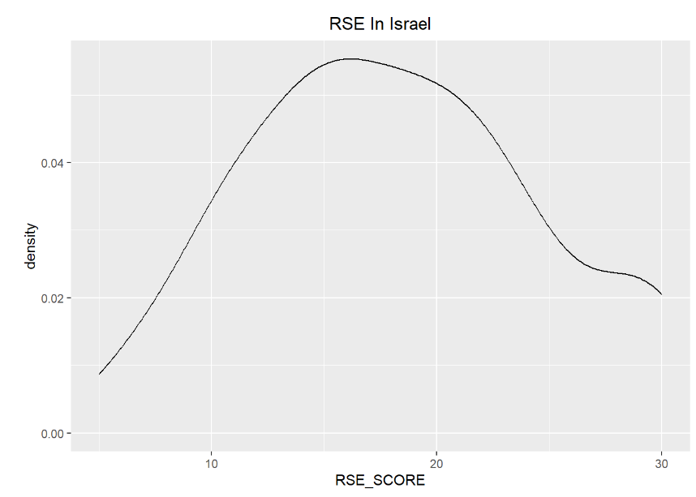
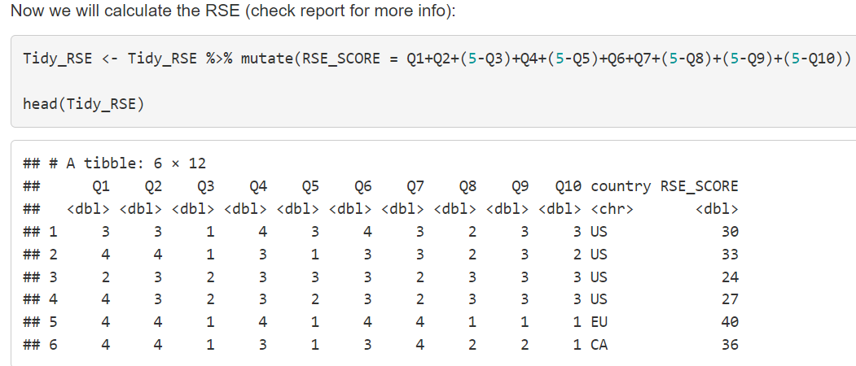
Workflow
Workflow
Pre-processed the data, which included: importing, cleaning, transforming, handling missing values, outlier detection, visualizations. We also had to score the different tests ourselves using the literature standards to interpret every test’s results.
Note - We had four different datasets to pre-process, each containing different personality traits data.
Research Stage
Pre-Processing Stage
Data Analysis Stage

Slide 11
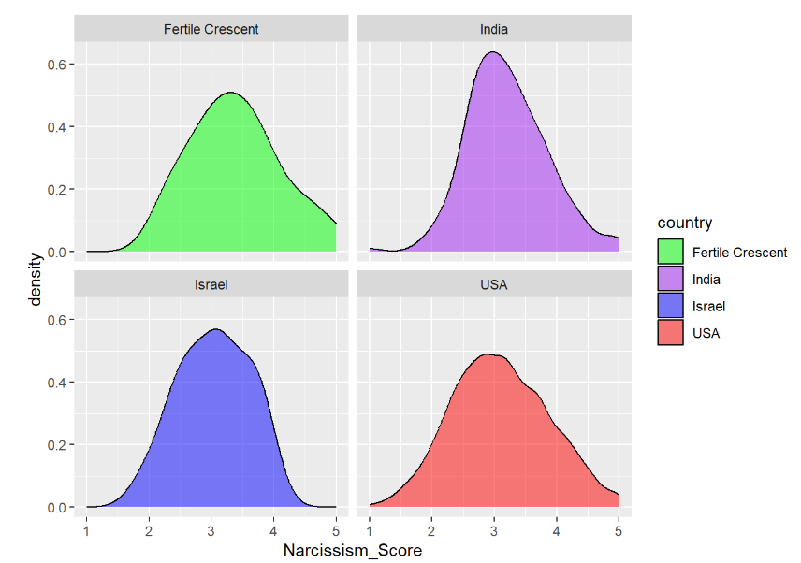
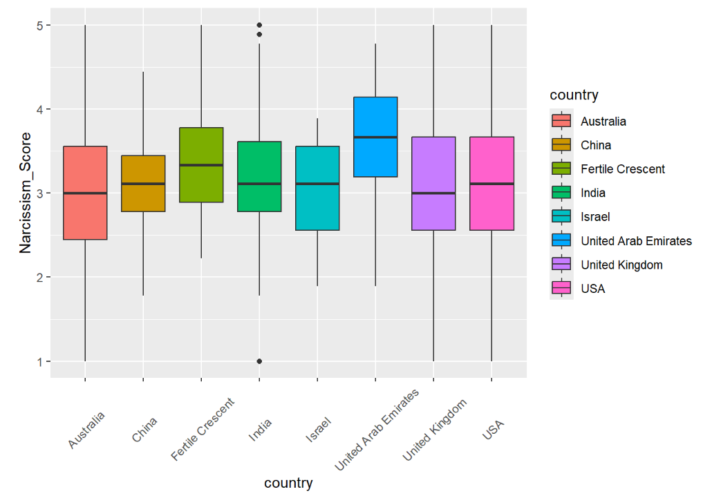
Workflow
Workflow
Research Stage
Pre-Processing Stage
Data Analysis Stage

Slide 12
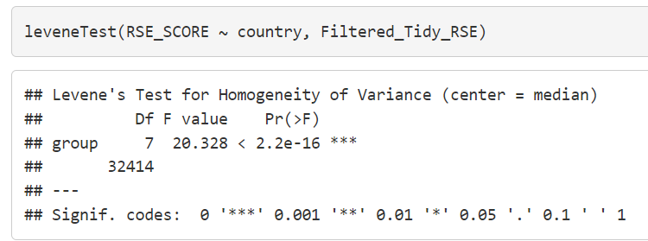
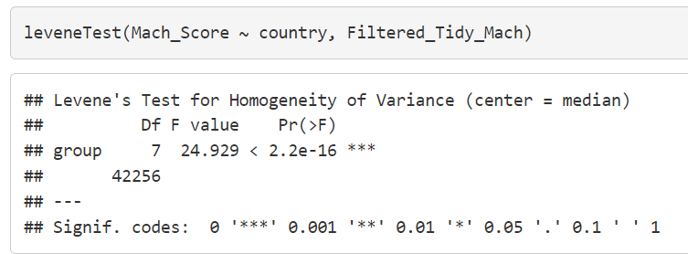
Workflow
Workflow
Researched various tests that could fit for our data analysis and considered using ANOVA.
After consistent violations of the homogeneity of variances assumption, we conducted additional research to explore alternative tests.
Decided to run Welch’s ANOVAs and Welch’s t-tests for our analysis.
Before we ran the tests, we dealt with the threat of alpha inflation in various ways.
Research Stage
Pre-Processing Stage
Data Analysis Stage

Slide 13
Data Analysis – Analysis Of Variances (ANOVA)
Analysis
ANOVA is a statistical analysis tool used to analyze the differences among means between multiple groups.
The name ANOVA can be confusing – the method is called this way because we use sample variances as a tool to infer about population means.
In contrast to t-tests, ANOVA supports comparisons between more than 2 groups.
This research used a variation of ANOVA that does not assume homogeneity of variances – Welch’s ANOVA.
We will present the formulas of the standard ANOVA to explain the logic behind the method. Welch’s ANOVA uses the same logic, but the formulas are much more cumbersome.

Slide 14

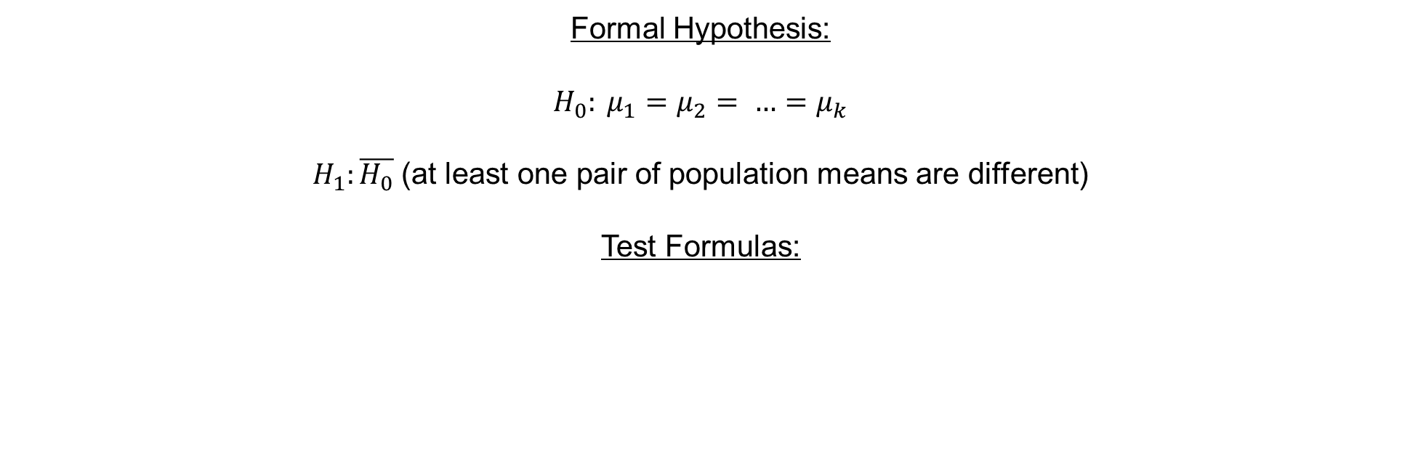

Data Analysis – Analysis Of Variances (ANOVA)
Analysis
Formal Hypothesis:
$H_{0}: μ_{1}=μ_{2}= …=μ_{k}$
$H_{1}:\overline{H_{0}}$ (at least one pair of population means are different)
Test Formulas:
$$F= \frac{MSB}{MSW}$$
$$MSB= \frac{\sum_{j=1}^{k}{n_{j}{({\overline{x}}_{j}−\overset{̿}{x})}^{2}}}{k−1}$$
$$MSW= \frac{\sum_{j=1}^{k}{{(n}_{j}−1){S_{j}}^{2}}}{N−k}$$
$${df}_{MSB}=k−1$$
$${df}_{MSW}=N−k$$
$$Where:$$
$$\overline{x_{j}}=mean for group j$$
$$\overset{̿}{x}=mean across all groups$$
$$S_{j}=standard deviation for group j$$
$$n_{j}=sample size for group j$$
$$k=number of groups$$
$$N=\sum_{j=1}^{k}{n_{j}=cumulative sample size}$$
$$F=the F statistic$$
$$df=degrees of freedom$$

Slide 15
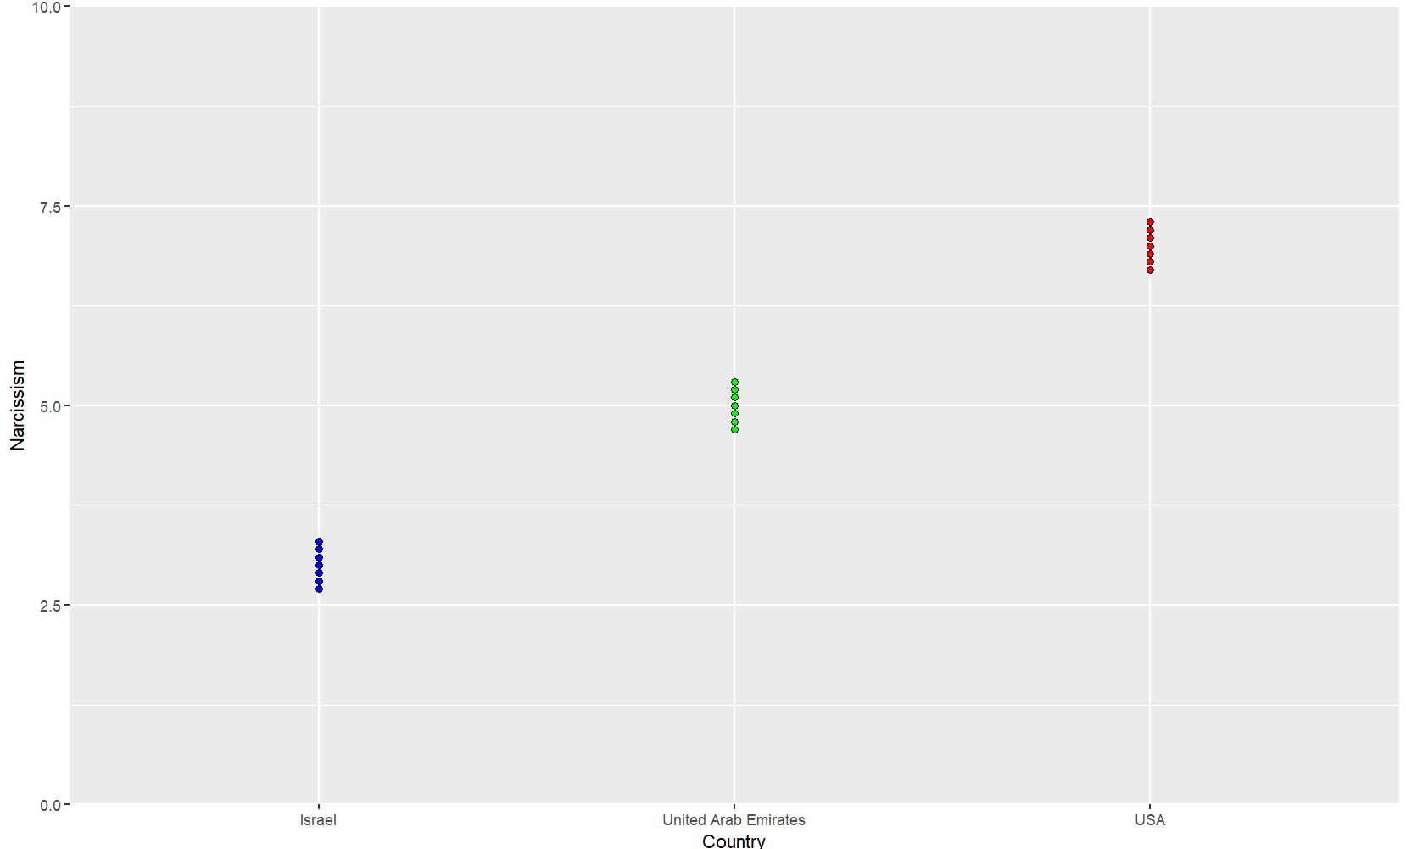

Data Analysis – Analysis Of Variances (ANOVA)
Analysis
$$F= \frac{MSB}{MSW}$$
$$MSB= \frac{\sum_{j=1}^{k}{n_{j}{({\overline{x}}_{j}−\overset{̿}{x})}^{2}}}{k−1}$$
$$MSW= \frac{\sum_{j=1}^{k}{{(n}_{j}−1){S_{j}}^{2}}}{N−k}$$
$${df}_{MSB}=k−1$$
$${df}_{MSW}=N−k$$
Notes:
אותם ממוצעים..

Slide 16
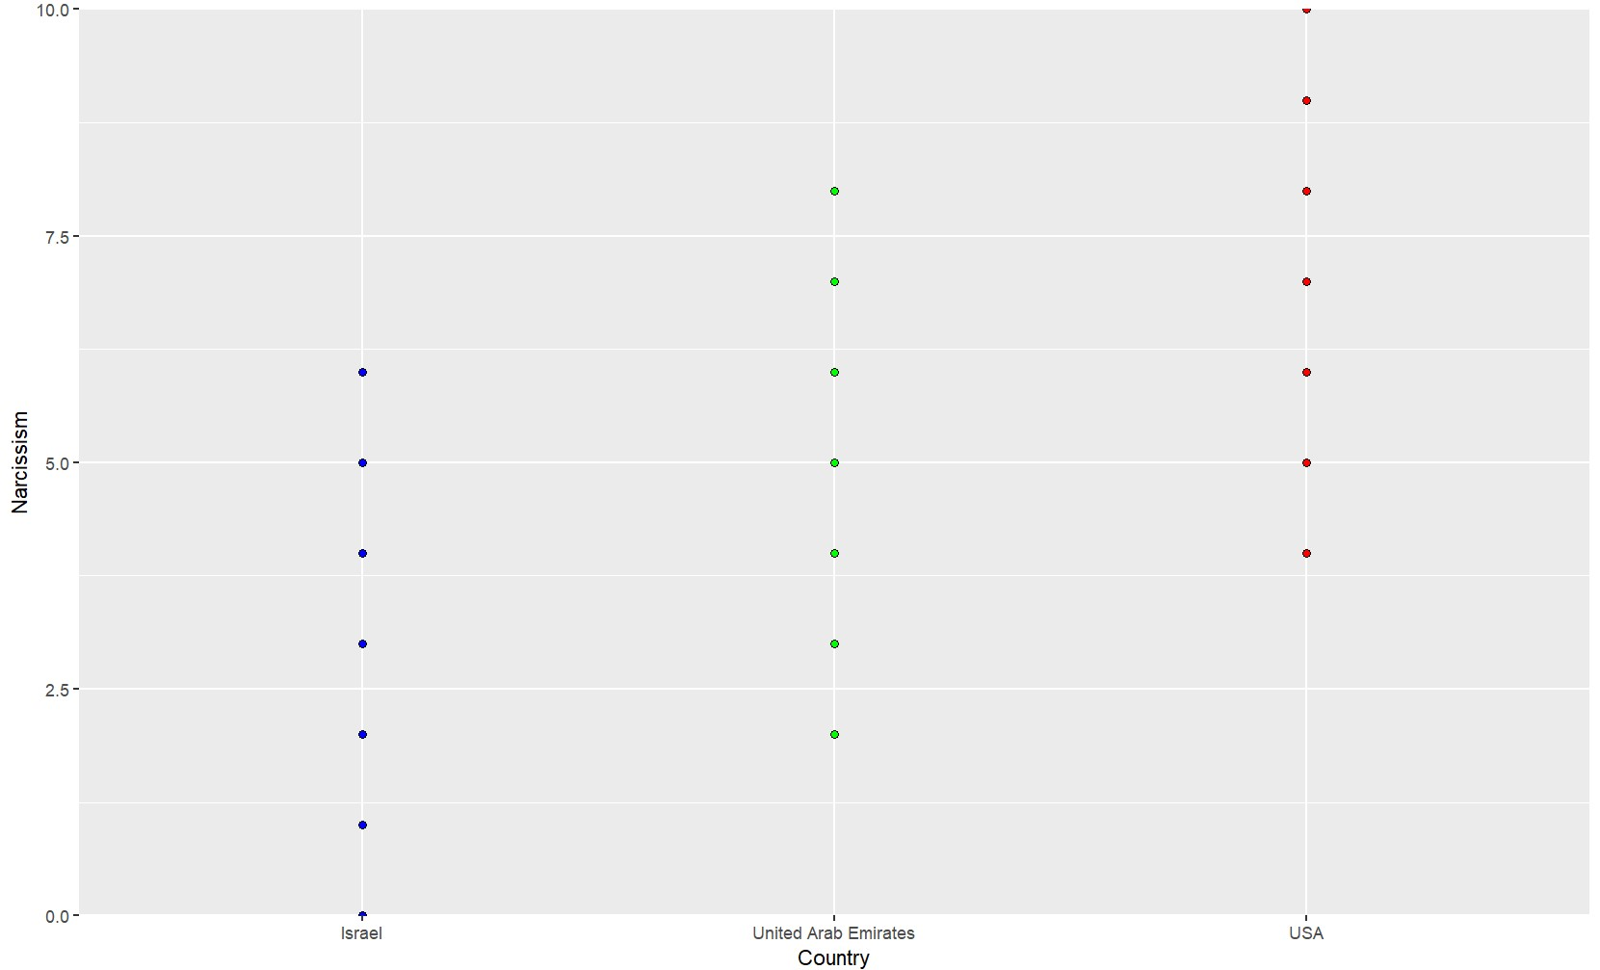
Data Analysis – Analysis Of Variances (ANOVA)
Analysis
$$F= \frac{MSB}{MSW}$$
$$MSB= \frac{\sum_{j=1}^{k}{n_{j}{({\overline{x}}_{j}−\overset{̿}{x})}^{2}}}{k−1}$$
$$MSW= \frac{\sum_{j=1}^{k}{{(n}_{j}−1){S_{j}}^{2}}}{N−k}$$
$${df}_{MSB}=k−1$$
$${df}_{MSW}=N−k$$

Slide 17
Data Analysis – Analysis Of Variances (ANOVA)
Analysis
We have 9 dependent variables in our research, so we conducted 9 Welch’s ANOVA. Each ANOVA was conducted to compare 8 countries (groups).
Significant F value tells the researcher that significant differences exist between the groups with a (1-a)*100 % confidence level.
If the researcher wants to understand where the differences came from, additional tests are required.
After each “successful” ANOVA test, we conducted 7 Welch’s t-tests between Israel and the other countries, to detect significant differences.

Slide 18



Data Analysis – Welch’s t-test
Analysis
Formal Hypothesis:
$$H_{0}: μ_{1}=μ_{2}$$
$$H_{1}:μ_{1}≠μ_{2}$$
Test Formulas:
$$t= \frac{\overline{x_{1}}−\overline{x_{2}}}{\sqrt{\frac{S_{1}^{2}}{n_{1}}+ \frac{S_{2}^{2}}{n_{2}}}}$$
$$df= \left\lfloor \frac{{\left(\frac{S_{1}^{2}}{n_{1}}+ \frac{S_{2}^{2}}{n_{2}}\right)}^{2}}{\frac{{\left(S_{1}^{2}\right)}^{2}}{n_{1}^{2}\left(n_{1}−1\right)}+\frac{{\left(S_{2}^{2}\right)}^{2}}{n_{2}^{2}\left(n_{2}−1\right)}}\right\rfloor$$
$$Where:$$
$$\overline{x_{i}}=mean for group i$$
$$S_{i}=standard deviation for group i$$
$$n_{i}=sample size for group i$$
$$t=the t statistic$$
$$df=degrees of freedom$$

Slide 19
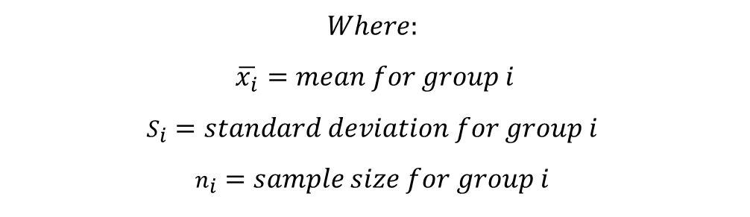
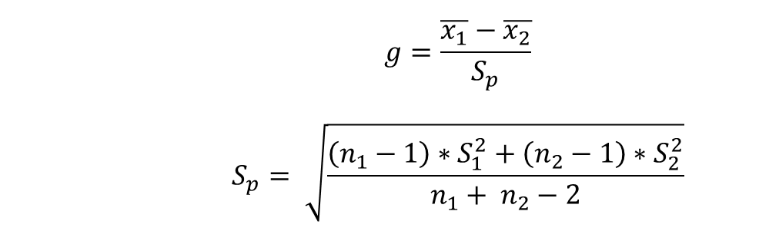
Data Analysis – Hedges’g
Analysis
Hedge’s g is a measure of effect size.
Effect size tells the researcher how much 2 groups differ.
After a t-test showed a significant result, we used hedge’s g.
Hedge’s g formula:
$$g=\frac{\overline{x_{1}}−\overline{x_{2}}}{S_{p}}$$
$$S_{p}= \sqrt{\frac{\left(n_{1}−1\right)∗S_{1}^{2}+\left(n_{2}−1\right)∗S_{2}^{2}}{n_{1}+ n_{2}−2}}$$
$$Where:$$
$$\overline{x_{i}}=mean for group i$$
$$S_{i}=standard deviation for group i$$
$$n_{i}=sample size for group i$$

Slide 20
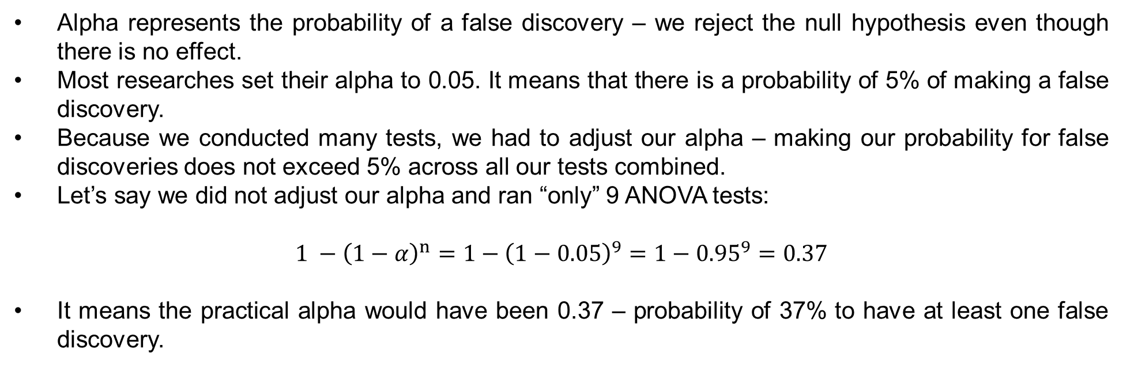
Data Analysis – Alpha Inflation
Analysis
Alpha represents the probability of a false discovery – we reject the null hypothesis even though there is no effect.
Most researches set their alpha to 0.05. It means that there is a probability of 5% of making a false discovery.
Because we conducted many tests, we had to adjust our alpha – making our probability for false discoveries does not exceed 5% across all our tests combined.
Let’s say we did not adjust our alpha and ran “only” 9 ANOVA tests:
$$1 −{\left(1−α\right)}^{n}=1−{\left(1−0.05\right)}^{9}=1−{0.95}^{9}=0.37$$
It means the practical alpha would have been 0.37 – probability of 37% to have at least one false discovery.

Slide 21
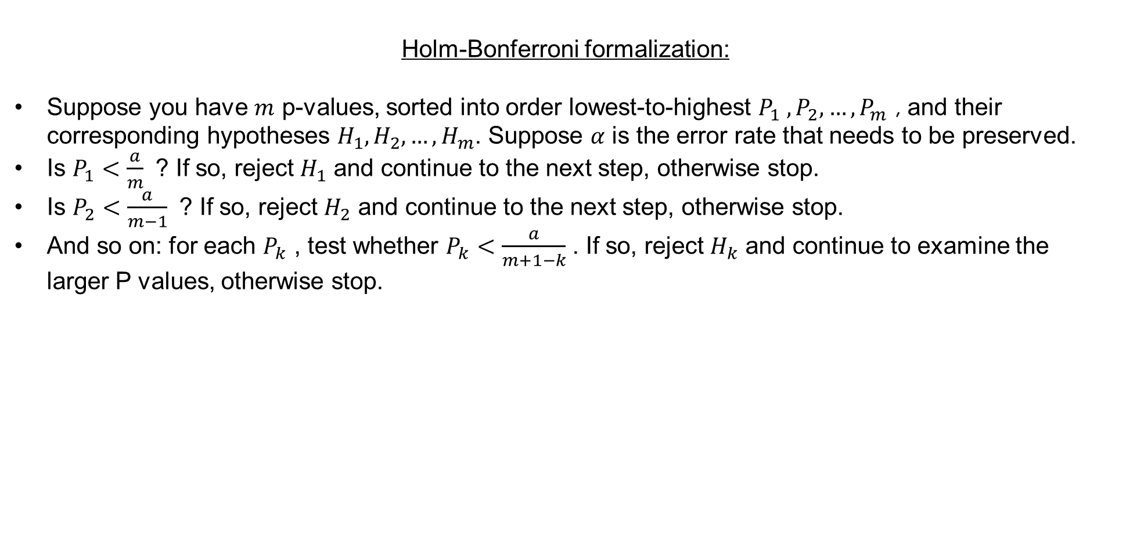
Data Analysis – Alpha Inflation
Analysis
We used Bonferroni correction to adjust our alpha to multiple ANOVAs.
The Bonferroni correction is trivial: the alpha is divided by the number of tests (9 in our case).
If an ANOVA was found significant, we ran another 7 Welch’s t-tests (Israel vs countries).
Further correction was used for those t-tests: the Holm-Bonferroni correction.
Holm-Bonferroni formalization:
Suppose you have $m$ p-values, sorted into order lowest-to-highest $P_{1} ,P_{2},…,P_{m}$ , and their corresponding hypotheses $H_{1}, H_{2},…, H_{m}$. Suppose $α$ is the error rate that needs to be preserved.
Is $P_{1}<\frac{a}{m}$ ? If so, reject $H_{1}$ and continue to the next step, otherwise stop.
Is $P_{2}<\frac{a}{m−1}$ ? If so, reject $H_{2}$ and continue to the next step, otherwise stop.
And so on: for each $P_{k}$ , test whether $P_{k}<\frac{a}{m+1−k}$ . If so, reject $H_{k}$ and continue to examine the larger P values, otherwise stop.

Slide 22
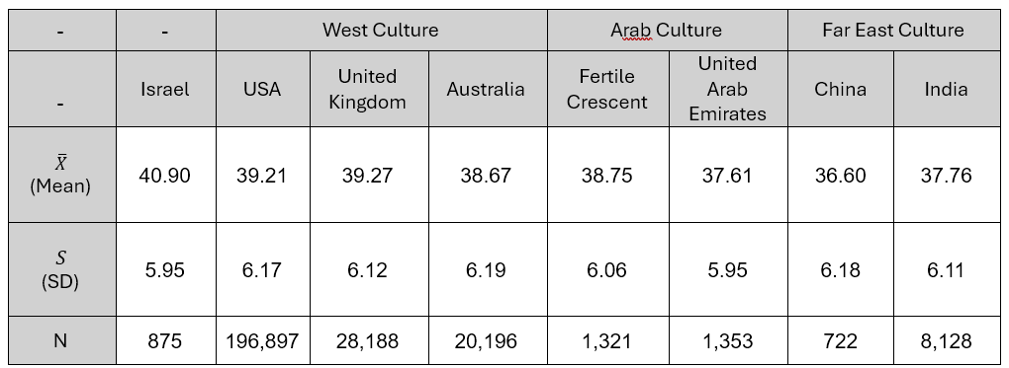
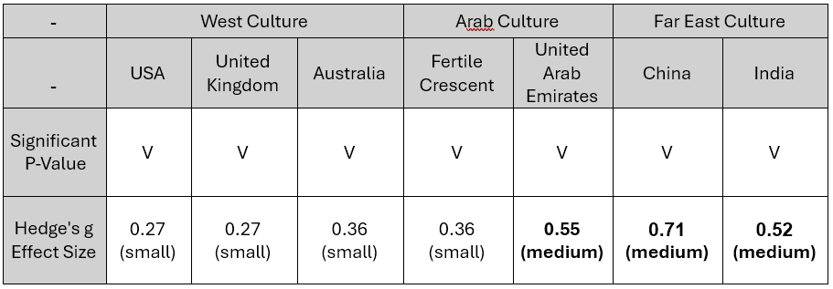
Results – Openness To Experience
Results
Note: Openness to experience’s range is 10-50.
Descriptive Results
Results (Israel vs)

Slide 23
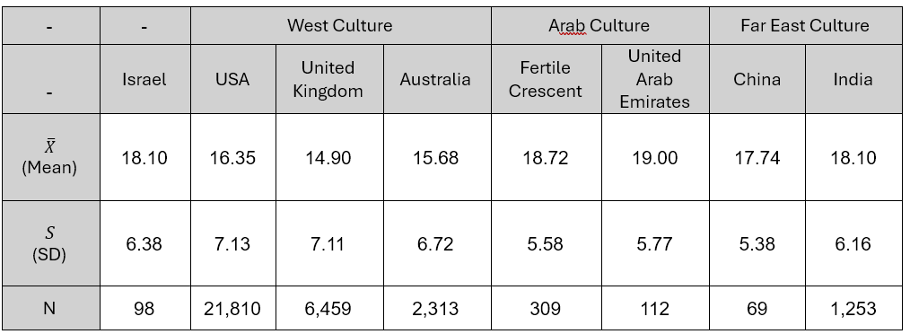
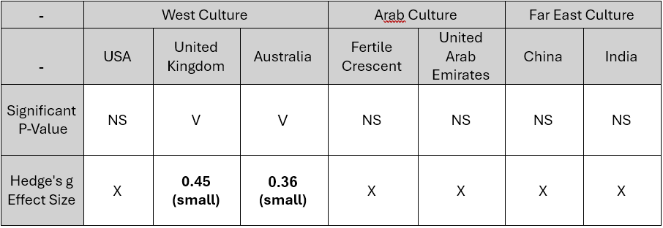
Results – Self Esteem
Results
Note: Self Esteem’s range is 0-30.
Descriptive Results
Results (Israel vs)

Slide 24
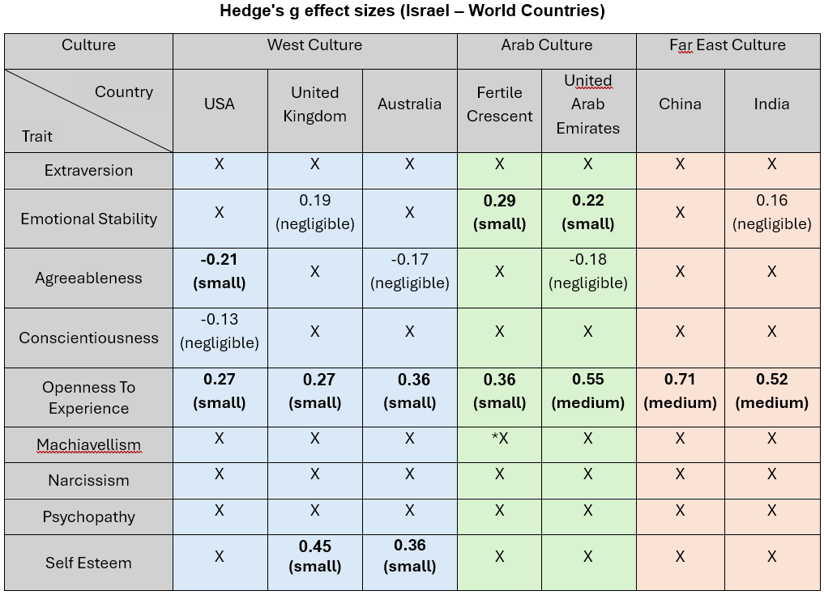
Results
Results

Slide 25
Conclusions
Conclusions
The most appropriate classification for the Israeli population based on our results is Far Eastern classifications. This result should be taken with a grain of salt because of project limitations –specifically the sample size differences.
Israel is the most open to experiences and shows significant differences when compared to all other countries. Additionally, we observe a pattern – the more you go “east”, the difference between Israel and the culture grows bigger. We suggest this finding is related to the unique circumstances that led to the establishment of Israel and the unique reality the population of Israel is facing even today.
China has shown the lowest standard deviations in the measures of most personality tests – which indicates it has the most homogenous population. It makes sense because of China’s oppressive regime.
The Arab World consistently showed the highest descriptive scores in the dark triad measurements (Machiavellianism, Narcissism, Psychopathy) compared to other countries. We think the small samples from The Arab World hurt our statistical power and thus we found no significant differences. Further study is recommended.

Slide 26
Main Limitations
Limitations
There was no random sampling for this project. The population sampled in this research is “People who entered the website OpenPsychometrics and chose to fill english questionnaires voluntarily”. There is a threat that the sample does not represent the general population of the various countries and contains biases.
For example: If only the most educated individuals speak English in Syria, it means we tested the scholarly population of Syria and not the general population like we intended to.
There is a problem of reliability when people self-report traits that they not consider neutral. Most people would rather view themselves in a positive light. It may be better to ask an individual’s close circles about those traits or measure the trait directly using behaviors (but it is much harder to obtain).
There were some big differences in sample sizes. The meaning of that is statistical power differences that can give wrong impressions about results. It was easier to detect effects in the west compared to other cultures because of the west’s massive samples.

